Slide 1


Sambe Consulting BIOps Presentation 08 May 2024
Data Led: Intelligent Insights
www.sambeconsuting.com

Slide 2



Agenda
1
Use Case Scenario
4
2
Use Case Scenario(Cont.)
5
Use Case Diagram
3
7
4
Sequence of Demo
9
5
Sequence of Demo (Cont.)
11
5
SSIS & Elasticsearch Demo
12

Slide 3


Understanding BIOps
By
Data Led: Intelligent Insights

Slide 4
Understanding BIOps

Slide 5
Use Case Scenario
By
Data Led: Intelligent Insights

Slide 6
Use Case Scenario

Slide 7
BIOps Environment Workflow
By
Data Led: Intelligent Insights

Slide 8
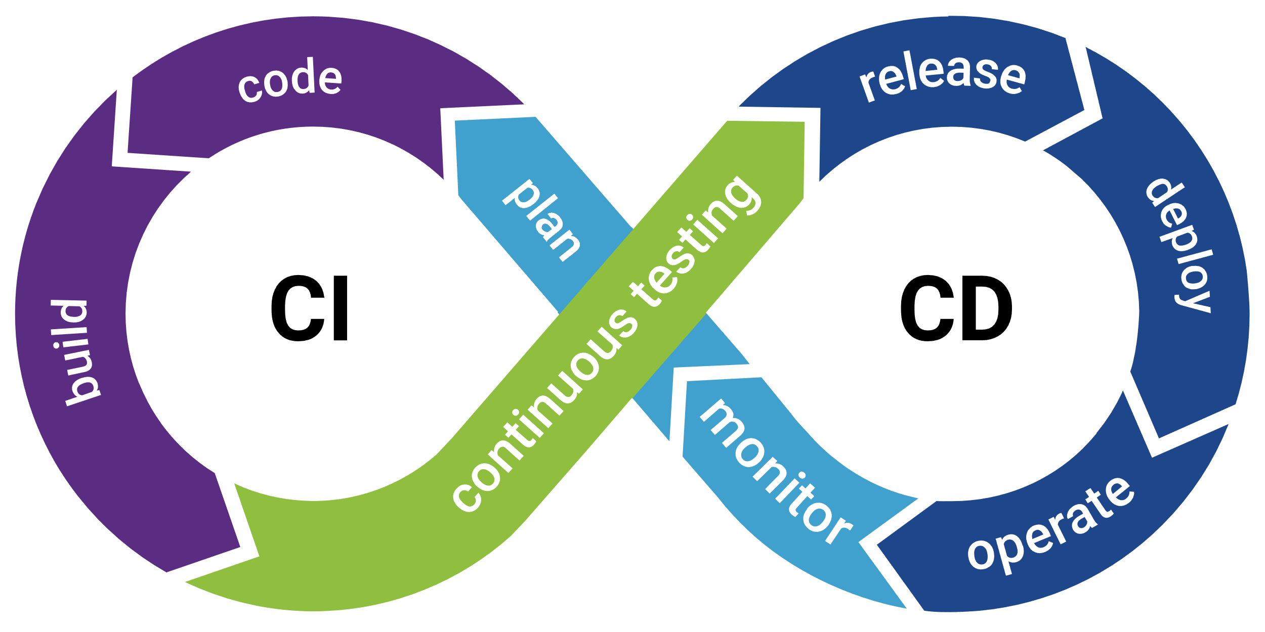
BIOps Environment Workflow

Slide 9


BIOps Environment Workflow
CI Pipeline
Main
Finalised Version
Looks Good Let's Deploy!
Dev
Pre-Prod Version

Slide 10








BIOps Environment Workflow (cont.)
CD Pipeline
Client
Main
Power BI Service

Slide 11
Sequence of Demo
By
Data Led: Intelligent Insights

Slide 12
Sequence of Demo

Slide 13







Sequence of Demo

Slide 14
BIOps Demo
By Chosen Ones Graduate Team
Data Led: Intelligent Insights

Slide 15




Thank You
Chosen Ones – Sambe Consulting
2024 Graduates
-
info@sambeconsulting.co.za
www.sambe.co.za
1 Maxwell Drive, Woodmead, Sandton, 2191
Data Led: Intelligent Insights
www.sambeconsuting.com

